Slide 1
Major Project Phase-II UNDER THE SUPERVISION OF A presentation by: Dr DEEPTI KAKKAR Sourav kumar, Dr ASHISH RAMAN Sai vamsi Biyyapu, Sanampreet Singh
SMART PHOTO ALBUM USING Face Recognition and custering

Slide 2
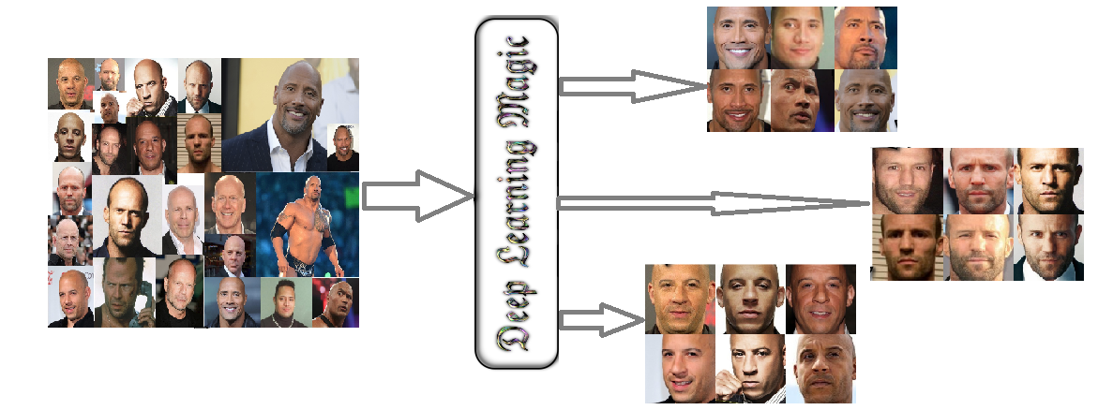
Introduction

Slide 3
TRAINING(LEARNING) of Model
• Residual n/w of Google(Std. n/w)
•AWS(cloud computing Service)
• Provide virtual environment to run linux
• Based on NVIDIA ‘S k80 GPU
• Costs $.98/hr
• processors 2 x 2496
• VRAM(video RAM) 24GB
• memory clock 5 GHz

Slide 4
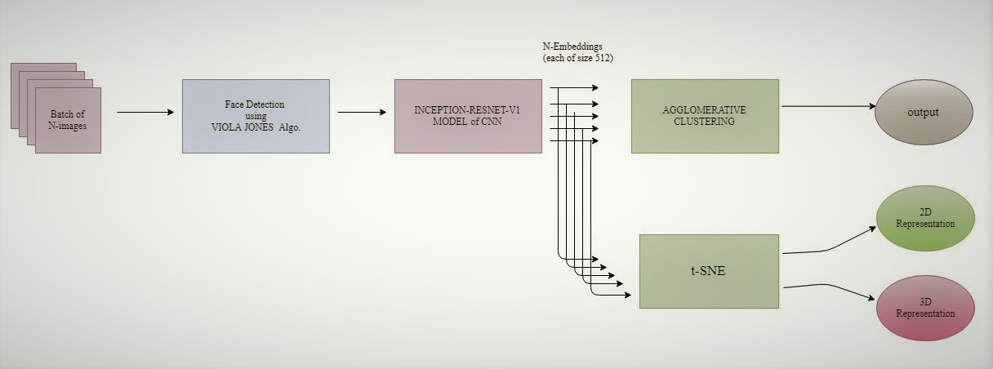
Model Structure

Slide 5
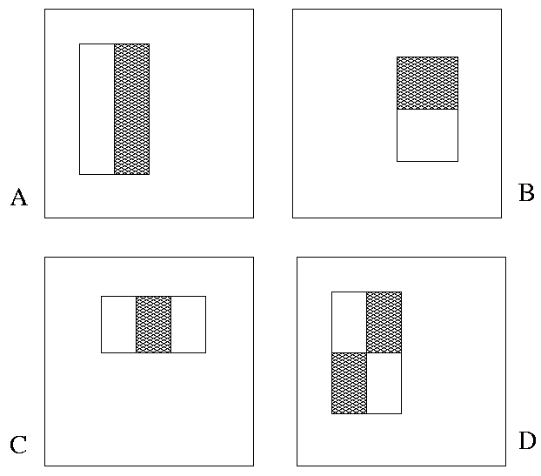
The Viola/Jones Face Detector
“Rectangle filters” Value = ∑ (pixels in white area) – ∑ (pixels in black area)

Slide 6
Computing the integral image
ii(x, y-1)
s(x-1, y)
i(x, y)
Cumulative row sum: s(x, y) = s(x–1, y) + i(x, y)
Integral image: ii(x, y) = ii(x, y−1) + s(x, y)
MATLAB: ii = cumsum(cumsum(double(i)), 2);

Slide 7
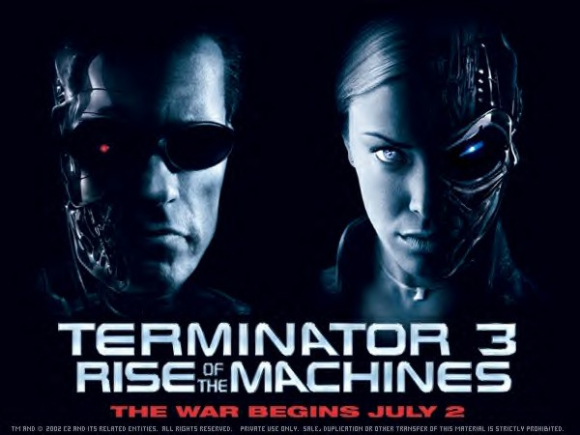
Example
Integral Image
-1
+1
+2
-2
-1
+1

Slide 8
Model Structure
Boosting is a classification scheme that works by combining weak learners into a more accurate ensemble classifier
A weak learner need only do better than chance
Training consists of multiple boosting rounds
During each boosting round, we select a weak learner that does well on examples that were hard for the previous weak learners
“Hardness” is captured by weights attached to training examples

Slide 9
Boosting illustration
Weights
Increased

Slide 10
Boosting for face detection
Define weak learners based on rectangle features
value of rectangle feature
parity
threshold
window

Slide 11
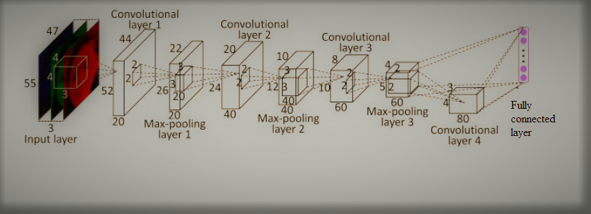
CNN
Basic operations in cnn:
1) Convolution
2) Non Linearity (ReLU)
3) Pooling or Sub Sampling
4) Classification (Fully Connected Layer)

Slide 12
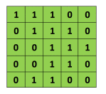
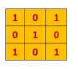
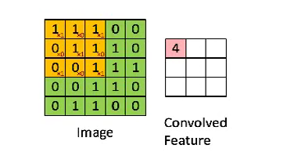
convolution
Grayscale image filter of size 3 x 3 ‘Convolved Feature’ or ‘Activation Map’ or ‘Feature Map’

Slide 13
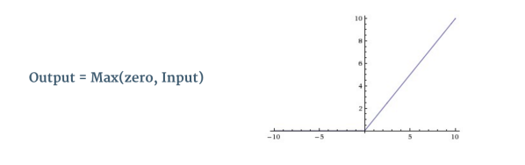
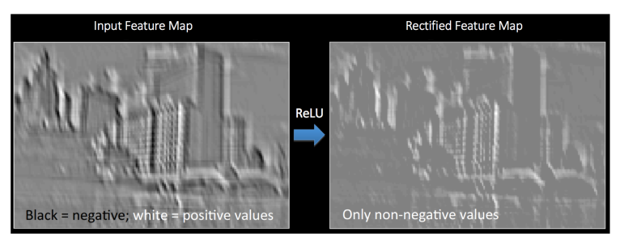
Non Linearity (ReLU)
ReLU stands for Rectified Linear Unit and is a non-linear operation. Its output is given by:

Slide 14
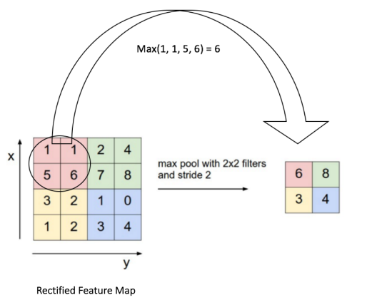
Pooling(maximum)
It reduces the dimensionality of each feature map but retains the most important information Pooling can be of different types: Max, Average, Sum etc.

Slide 15
Fully Connected Layer
The term “Fully Connected” implies that every neuron in the previous layer is connected to the neurons of this layer.
It uses a softmax activation function in the output layer
The purpose of the Fully Connected layer is to use these features for classifying the input image into various classes based on the training dataset.

Slide 16
CLUSTERING ALGORITHMS
Partitioning Algorithms
K-Means
DBSCAN
Hierarchical Algorithms
Agglomerative Clustering

Slide 17
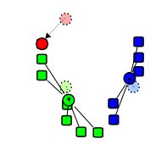
K-Means Partitional clustering
Prototype based Clustering
method of vector quantization
k-means clustering aims to partition n observations into k clusters in which each observation belongs to the cluster with the nearest mean, serving as a prototype of the cluster.
The problem is computationally difficult (NP-hard); however, there are efficient heuristic algorithms that are commonly employed and converge quickly to a local optimum.

Slide 18
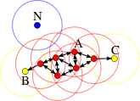
DBSCAN
Density based Clustering (Maximal Set of Density Connected Points) DBSCAN is very sensitive to clustering parameters MinPoints (Min Neighbourhood Points) and EPS (Images Next)‏ Given a set of points in some space, it groups together points that are closely packed together (points with many nearby neighbors), marking as outliers points that lie alone in low-density regions (whose nearest neighbors are too far away)

Slide 19
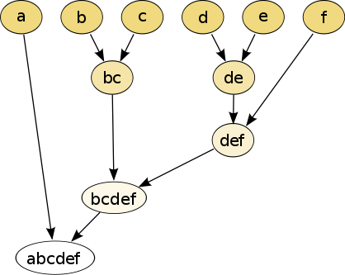
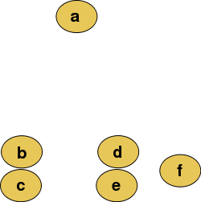
Agglomerative Hierarchical Clustering
Starting with one point (singleton) clusters and recursively merging two or more most similar clusters to one "parent" cluster until the termination criterion is reached. This is a "bottom up" approach: each observation starts in its own cluster, and pairs of clusters are merged as one moves up the hierarchy. Raw data Traditional Representation

Slide 20
T-SNE(t-Distributed Stochastic Neighbor Embedding)
If We are given a collection of N high-dimensional objects x1; :::xN
How can we get a feel for how these objects are arranged in the data space??
(t-SNE) is a technique which is used for dimensionality reduction and is particularly well suited for the visualization of high-dimensional datasets.

Slide 21
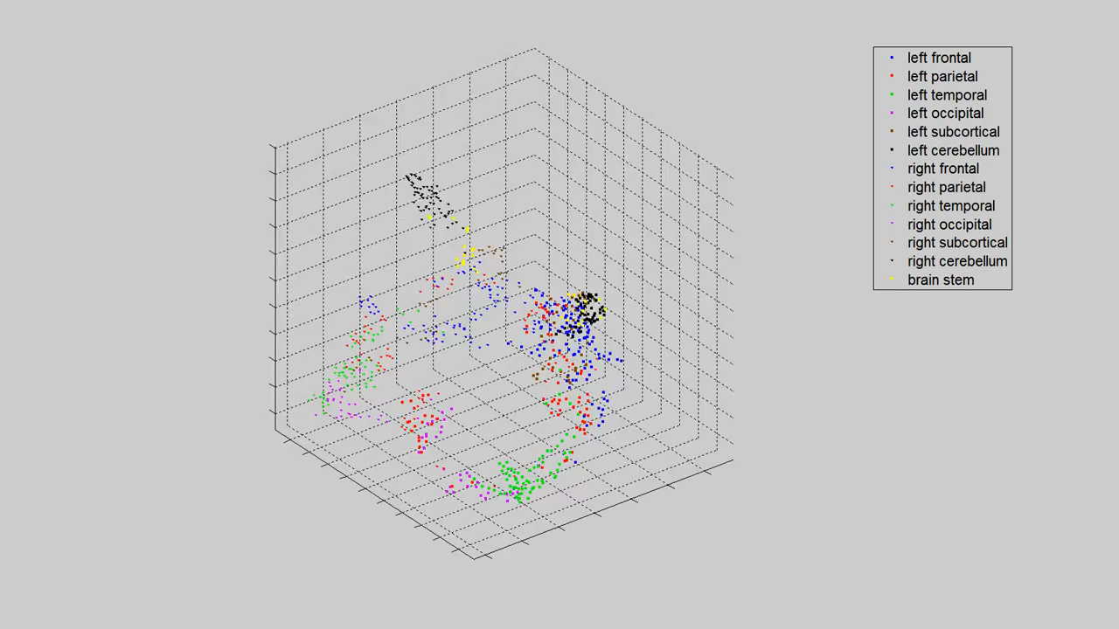
T-SNE Results(3D)

Slide 22
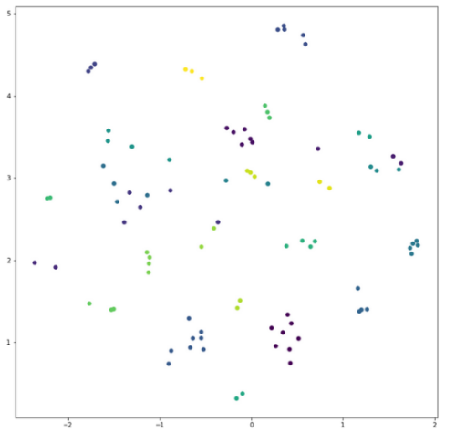
T-SNE Results(2D)

Slide 23
References
[1] Schroff, F., Kalenichenko, D., & Philbin, J. (2015). Facenet: A unified embedding for face recognition and clustering. In Proceedings of the IEEE conference on computer vision and pattern recognition (pp. 815-823).
[2] https://github.com/davidsandberg/facenet/wiki
[3] M. D. Zeiler and R. Fergus. Visualizing and understanding convolutional networks. CoRR, abs/1311.2901, 2013. 2, 3,4, 6.
[4] C. Szegedy, W. Liu, Y. Jia, P. Sermanet, S. Reed,D. Anguelov, D. Erhan, V. Vanhoucke, and A. Rabinovich. Going deeper with convolutions. CoRR, abs/1409.4842,2014. 2, 3, 4, 5, 6, 10.
[5] D. Chen, S. Ren, Y. Wei, X. Cao, and J. Sun. Joint cascade face detection and alignment. In Proc. ECCV, 2014. 7

Slide 24
Thank you

